Slide 1
Fall Detection
Machine Learning Problem
Mohammed Mushtaq Patel
SAP ID: 51689380

Slide 2
Content
Challenge Description (Abstract)
Current trend
Solution Proposed
Data & Pre-Processing
Model Flow
Performance Measures
Open Source/Research References
Future Work
Tools & Framework Used
GitHub Link with Code Documentation

Slide 3
Challenge Description
This challenge is to predict Fall i.e. FallDetection.
The data has been collected from Accelerometer, Gyroscope and Magnetometer
The data provided is consist of Fall related as well as other body movements like Walking, Sleeping, Running etc.
The purpose is to provide a model which can Identify the Fall

Slide 4
Current Trends
For the over-65 population, falling can be a serious health risk. Three million older people each year are treated in emergency rooms for fall-related injuries, according to the CDC, and one in four older adults falls each year.
The Apple Watch
Perhaps the most high-profile recent foray into fall detection came from Apple, which announced the addition of a fall detection feature to the Apple Watch Series 4 last year.
FallCall Solutions
Radar based 3D imaging

Slide 5
Data & Pre-Processing
The provided dataset consists of 6 features and a Target as mentioned in the table
The Objective is to predict the Fall, based on the data available.

Slide 6
Data Preprocessing
Below are the different pre-processing steps that we followed.
Missing values Detection.
Outlier Detection
Transformations
Z- Score
Min Max Scaling
Individual feature visualization
1.Histogram of sales

Slide 7
Model Flow
Loading
Library
Data
Preprocessing
Outlier Detection
Transformations
EDA
Histogram
Correlation Matrix
Modelling
ML Model
Model Performance
F1
Precision
Recall
Support
Reporting
Communicating the Outcome

Slide 8
Performance Evaluation
F1 Score
Precision
Recall
Support

Slide 9
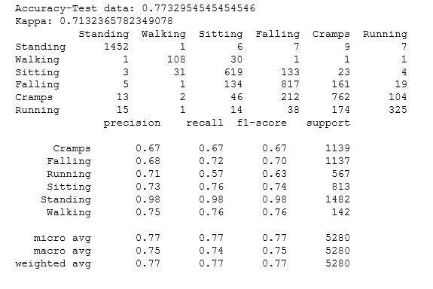
Score

Slide 10
Future Work
There is possibility of further improvement in Model
Exploration to improve the Accuracy of the Model
Try some more Tuning to increase the confidence in the outcome

Slide 11
Tool Used
Python
Jupyter Notebook

Slide 12
References
https://medium.com/@Mandysidana/machine-learning-types-of-classification-9497bd4f2e14
https://www.datacamp.com/community/tutorials/parameter-optimization-machine-learning-models
https://towardsdatascience.com/feature-engineering-in-python-part-i-the-most-powerful-way-of-dealing-with-data-8e2447e7c69e
https://www.analyticsvidhya.com/blog/2016/03/complete-guide-parameter-tuning-xgboost-with-codes-python/

Slide 13
Github Link

